Slide 1





Project Number: 230202
Workshop: Entrepreneurship in the Development of Software Products
Students: Nir Timor, Arad Pe’er, Omer Pessach
Moderator: Dror Margalit
1

Slide 2

OVERVIEW
A lot of people seek to travel in a group but find it difficult to get the right partners.
In our modern technological world, a digital-social solution is a must.
This is where LetsGo comes into the picture.
2
Notes:
Our platform takes the relevant parameters and builds a personal profile for each user.
With LetsGo travelers from all around the world will be able to meet new people and explore fascinating places together.

Slide 3

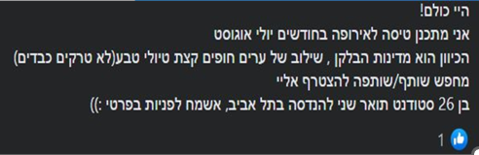
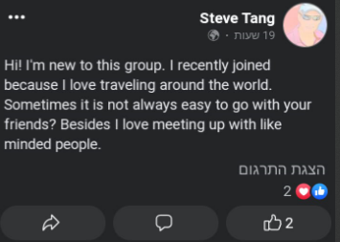

THE PROBLEM
Individuals struggle to find like-minded travel buddies.
Missed opportunities for shared experiences.
Safety concerns.
Lack of a dedicated platform.
3

Slide 4
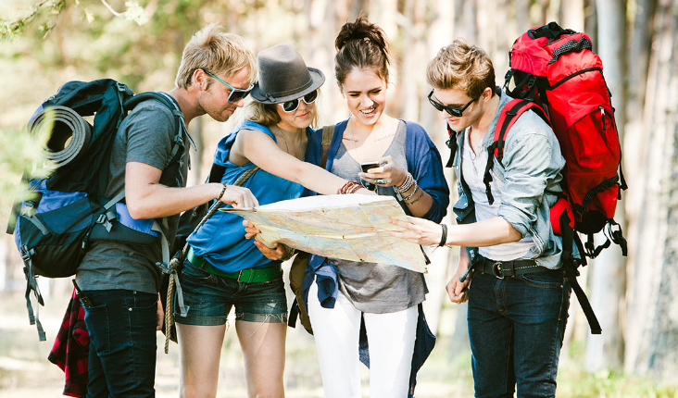

TARGET MARKET
Group travelers
Adventurers
Solo travelers
Travel enthusiasts
4

Slide 5

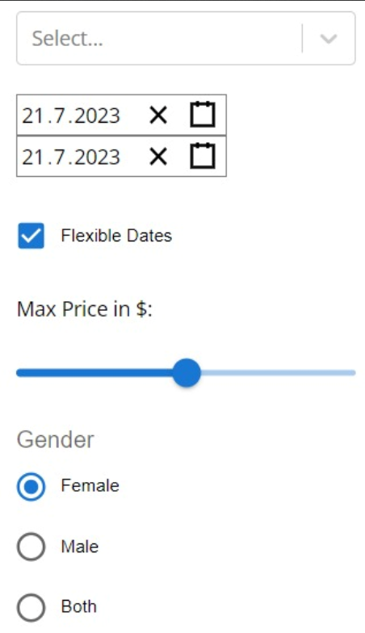

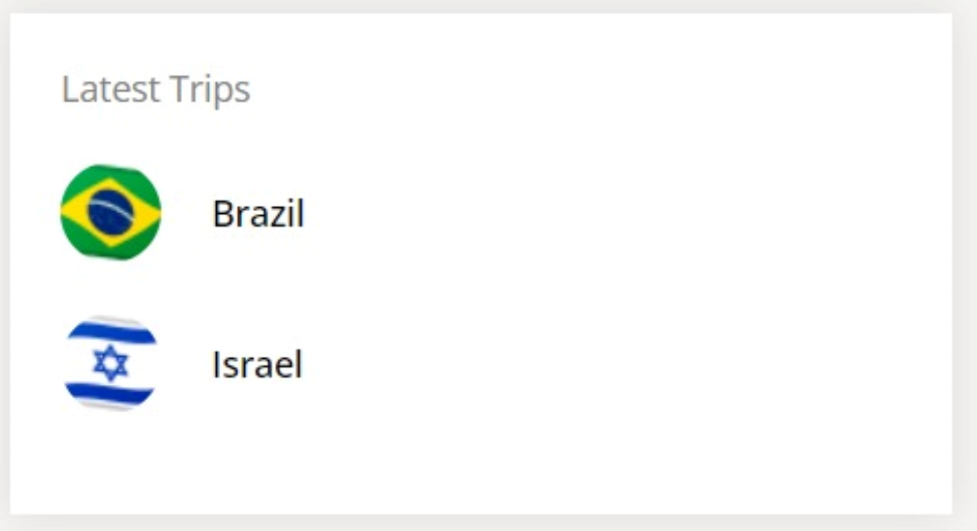
THE SOLUTION
Centralized Online Platform:
- Search by parameters: shared interests, travel preferences, and destination preferences.
- Interaction: profiles, chat, comments, likes.
- Dedicated platform for finding travel partners.
5

Slide 6
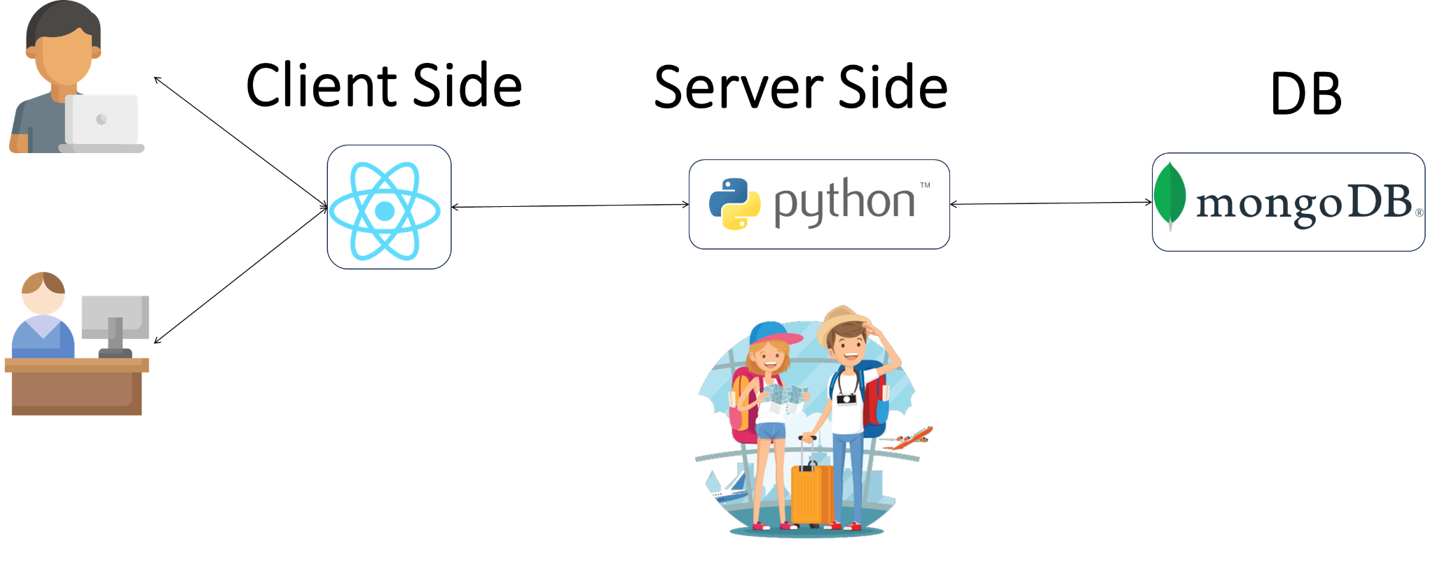

LETSGO’S ARCHITECTURE
6

Slide 7
Connect travelers with their ideal travel Companions, based on:
Destination, Traveling dates, Budget, Desired activities, Personality traits, etc.
LETSGO’S ALGORITHM
7

Slide 8






MARKET COMPETITION
Facebook - Limited visibility and search options, engagement and response rates.
WorkAway - Not a community, limited availability.
Couchsurfing - Connect with locals, stay with locals and host travelers, explore local social events.
 |  |  |  | Community
 |  |  |  | Availability
 |  |  |  | Search by Travel-Preferences
8

Slide 9

SUMMARY
Our web-based solution offers a specialized and efficient solution for travelers to find companions, promoting community building and enhancing travel experiences.
9

Slide 10
THANK YOU
FOR WATCHING!
Questions? ☺
“Life is an adventure best traveled together.”
10
Contact Us - 050-6429853

